Slide 1

Cybersecurity Awareness Course
This course will equip you with the knowledge and skills to stay ahead of cybersecurity threats and protect yourself and your organization from the growing world of cyberattacks. We will explore the evolving landscape of cybercrime, understand common threats and tactics, and learn practical strategies for safeguarding your online presence.

Slide 2

Introduction to Cybersecurity: A Vital Skill for Everyone
In today's digital world, cybersecurity is no longer just for tech experts. This presentation will provide an introduction to cybersecurity, covering the importance, the threat landscape, and strategies for protecting ourselves.

Slide 3




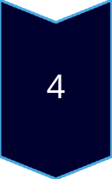
Why Cybersecurity Is Important
Protects sensitive company and customer information
Prevents financial loss from breaches
Safeguards company reputation
Preventing Malware and Ransomware

Slide 4
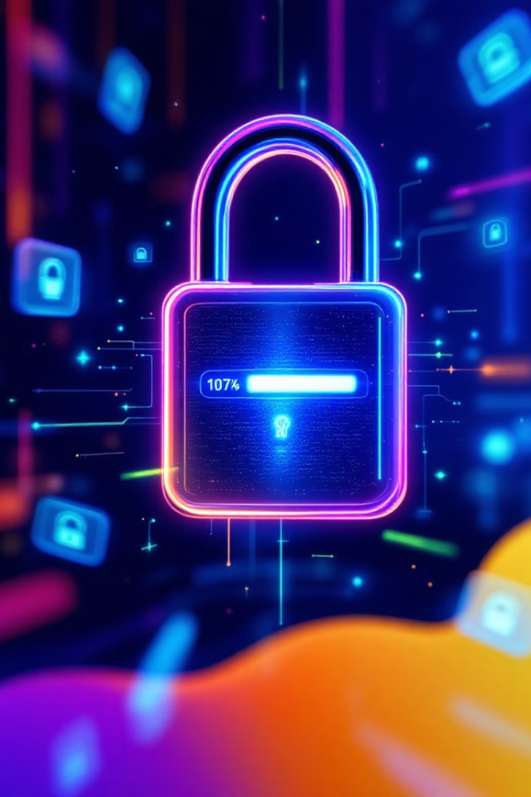
Human Error – The weakest link
82% of breaches involve a human element (source: Verizon DBIR 2023)
Examples of mistakes:
Clicking on phishing links
Sharing passwords
Misplacing sensitive documents

Slide 5

Human Error: A Major Threat
1
Phishing Attacks
2
Weak Passwords
3
Unpatched Software
Deceptive emails or messages to trick users into revealing sensitive information
Easily guessed or cracked passwords that compromise accounts
Outdated software with known vulnerabilities exploited by attackers

Slide 6

Real-World Case Studies
1
2023: The Colonial Pipeline Attack
Ransomware attack that caused major fuel shortages in the US
2
2022: The Log4j Vulnerability
Critical vulnerability in a popular software library exploited by attackers
3
2021: The SolarWinds Hack
Supply chain attack that compromised government and business networks

Slide 7

Real-World Example of a Breach
Lessons Learned from Notable Incidents
Brief Description:
Attackers gained access via a phishing email sent to an HVAC vendor.
The attackers used stolen credentials to infiltrate Target's network.
Impact:
40 million credit and debit card details were stolen.
Financial loss estimated at $162 million.
Significant damage to customer trust and company reputation.

Slide 8
Timeline of the Target Breach
Phishing email sent to HVAC vendor (Early 2013)
Vendor credentials stolen and used (Mid 2013)
Attackers infiltrate Target's network (Late 2013)
Data breach detected and publicized (Dec 2013)

Slide 9
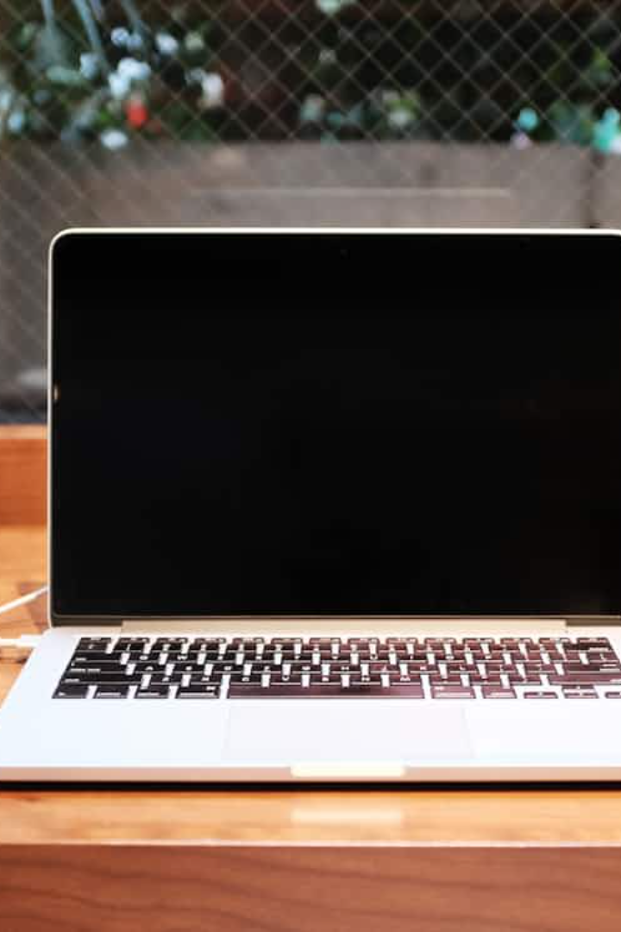
Key Principles of Cybersecurity
Strong Passwords
Regular Updates
Use unique and complex passwords for every account
Keep software and operating systems up to date
Be Suspicious
Multi-Factor Authentication
Verify links and attachments before clicking
Use an extra layer of security for account logins

Slide 10





Understanding the Threat Landscape
Malware
Hacking
Viruses, worms, and ransomware. They can damage your devices, steal your data, or hold it hostage for ransom.
Unauthorized access to computer systems
Phishing
Social Engineering
Emails, texts, or websites designed to trick you into revealing sensitive information or clicking on malicious links.
Manipulating people into performing actions or revealing confidential information through psychological tactics

Slide 11
Have you ever encountered a suspicious email, call or website? How did you handle it?

Slide 12
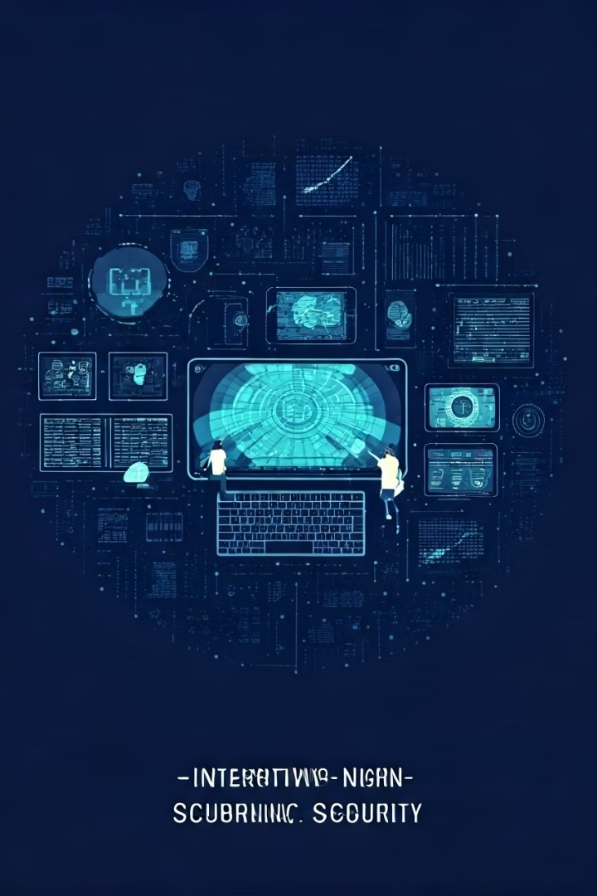
Activity: Match Threats to Descriptions
1. Divide into small groups.
2. Match the following descriptions to the correct threat type:
- A malicious email pretending to be from IT support.
- A program encrypting all files and demanding payment.
- An employee sharing sensitive data with unauthorized parties.
3. Discuss your answers as a group.

Slide 13
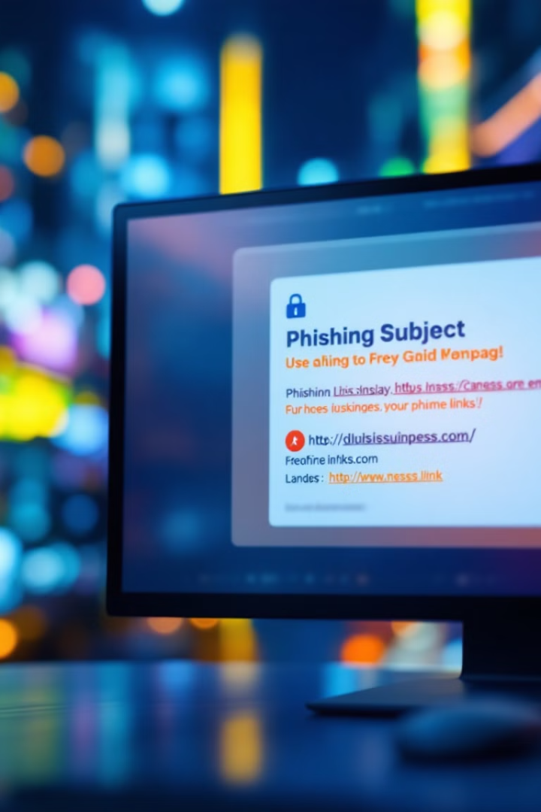


Interactive Exercises: Phishing and Social Engineering
Phishing Simulation
Social Engineering Role-Playing
Participants receive mock phishing emails to test their awareness.
Team members practice defending against social engineering tactics.

Slide 14

Social Engineering Tactics
Authority
Greed
Pretending to be a person in a position of power or authority to gain trust and compliance.
Offering rewards or incentives to manipulate behavior
Urgency
Intimidation
Creating a sense of urgency or limited availability to pressure victims into quick decisions.
Threatening or coercing victims into taking specific actions by leveraging fear.

Slide 15
Common Social Engineering Methods
Phishing
Pretexting
Fake emails or messages tricking victims into
revealing sensitive information
Creating a fabricated scenario to obtain confidential data
Baiting
Tailgating
Using physical or digital bait
(e.g., USB drives, free downloads)
Gaining physical access by following authorized personnel
Vishing
Voice phishing via phone calls

Slide 16
Activity: Role – Play scenarios
Instructions:
Form pairs or small groups.
One participant acts as the attacker, using social engineering tactics.
The other participant(s) play defenders, responding to the scenario.
Discuss the tactics used and how to counter them.
Scenarios:
An "IT admin" calls asking for login credentials.
A "vendor" requests access to a restricted area.
An email offers a "reward" for clicking a link.

Slide 17
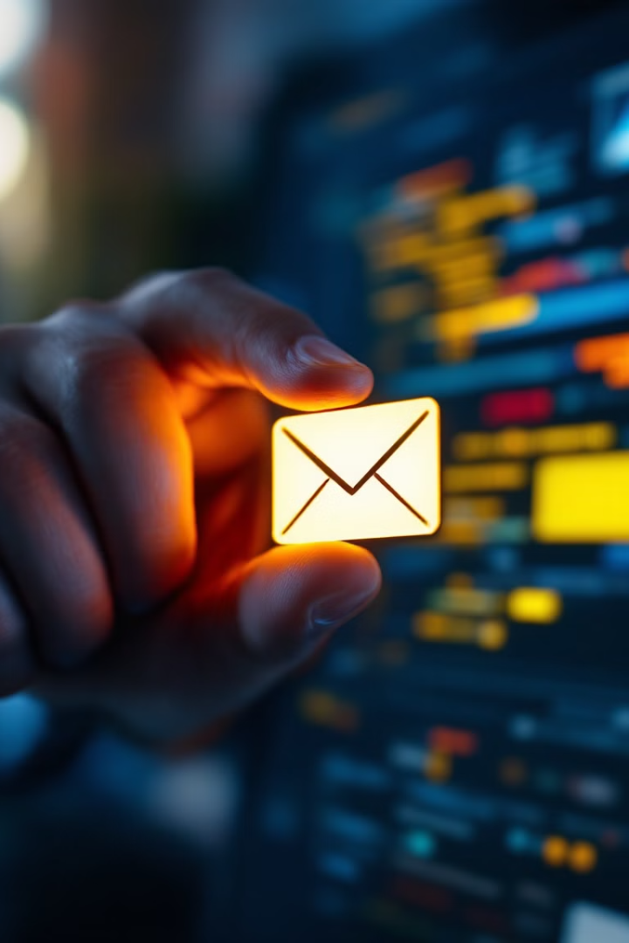
Recognizing Phishing Tactics
Content
May contain grammatical errors or requests for personal information.
Fake urgency
Impersonation
Pressuring you to act quickly, often using deadlines or limited-time offers.
Posing as a trusted source, like a bank or government agency.
Suspicious links or unusual attachments
Links that don't match the sender's domain or look odd.
Attachments - especially with file extensions like .exe, .zip, or .rar.

Slide 18





Password Security
Length
1
Aim for at least 12 characters or more.
2
Complexity
Use a mix of uppercase and lowercase letters, numbers, and symbols.
3
Uniqueness
Create different passwords for each account.
4
MFA
Enable two-factor authentication for an extra layer of protection.
5
Password Manager
Use a secure password manager to store and manage your passwords securely.

Slide 19
Secure Communication
HTTPS
1
Ensure the website you are visiting is using HTTPS, indicated by a padlock icon in the address bar.
VPN
2
A VPN encrypts your internet traffic and routes it through a secure server, protecting your privacy and security when using public Wi-Fi.
Secure Messaging Apps
3
Use end-to-end encrypted messaging apps for private conversations.
Email Encryption
4
Consider using email encryption tools to protect sensitive information sent through email.

Slide 20
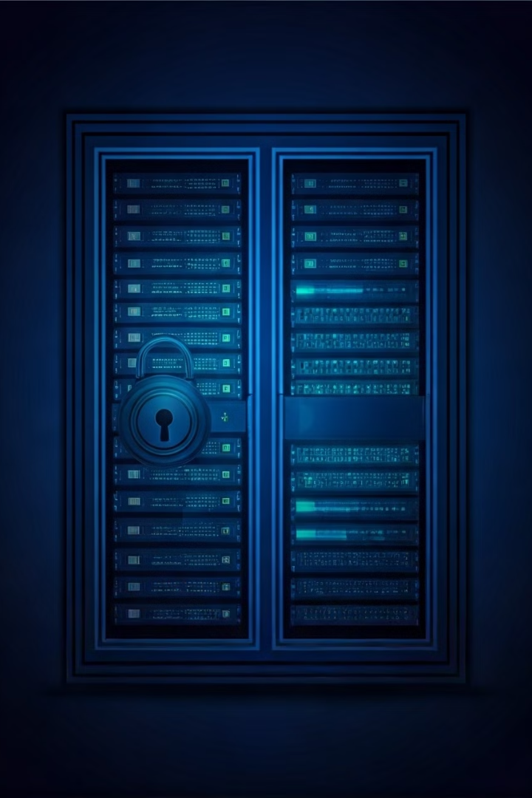
Data Protection and Handling
1
2
Identify
Protect
Classify data based on sensitivity levels.
Implement security measures like access controls and encryption.
3
4
Monitor
Respond
Regularly monitor for potential data breaches or misuse.
Have a plan in place to address incidents and restore data.

Slide 21



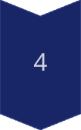

Reporting and Incident Response
Identify
Recognize a potential security breach or incident.
Contain
Limit the spread of the breach or incident and prevent further damage.
Eradicate
Remove the threat or malicious software from the system.
Recover
Restore affected systems and data to their original state.
Lessons Learned
Review the incident and implement corrective measures to prevent similar incidents in the future.

Slide 22
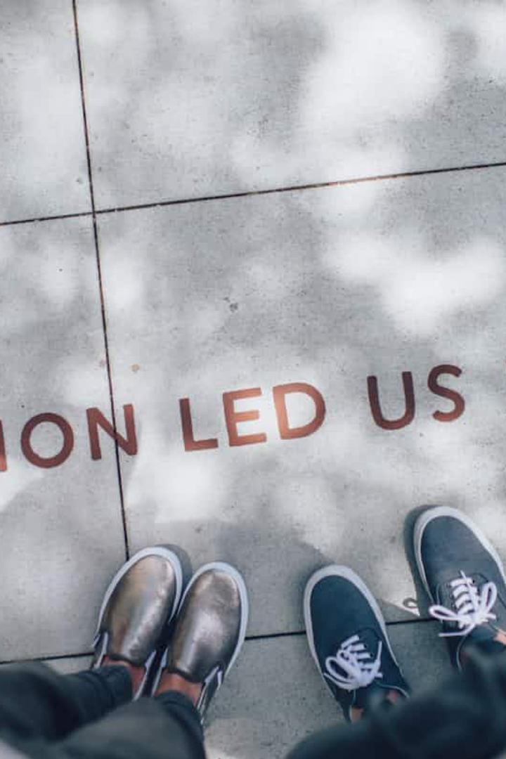
Stay Informed & Take Action
Cybersecurity is a continuous process. Keep learning, update your knowledge, and implement strong practices to stay ahead of threats.

Slide 23
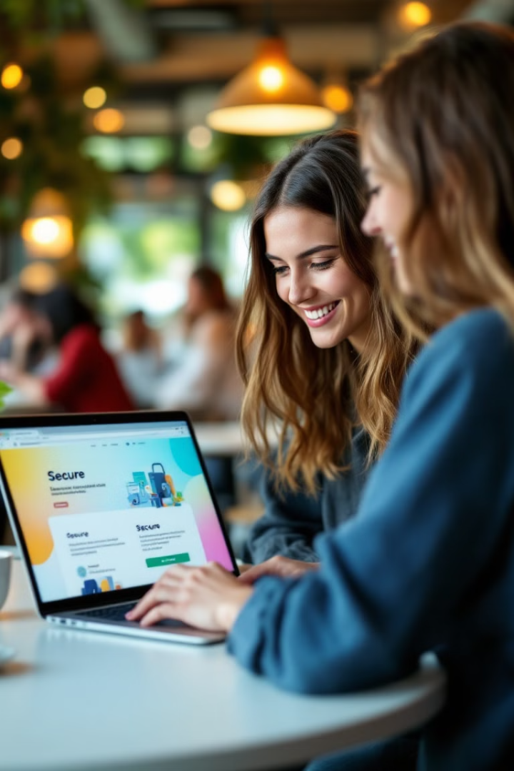
Safe Browsing Practices
1
Use reputable browsers
2
Avoid suspicious websites
Keep your browser updated with the latest security features.
Be cautious of websites with odd URLs or excessive pop-ups.
3
Enable security features
Turn on features like phishing and malware detection.

Slide 24
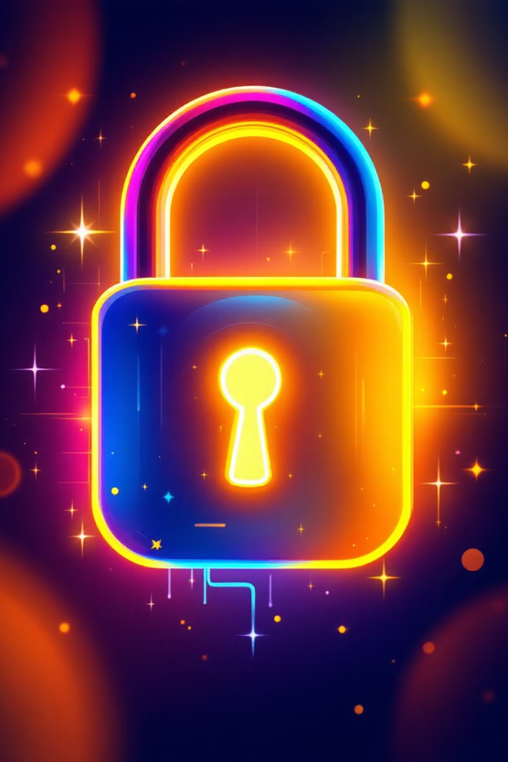



Password Security
Length and complexity
Uniqueness
Use a mix of uppercase and lowercase letters, numbers, and symbols.
Don't reuse the same password for multiple accounts.
Password manager
Store and manage your passwords securely with a dedicated tool.

Slide 25
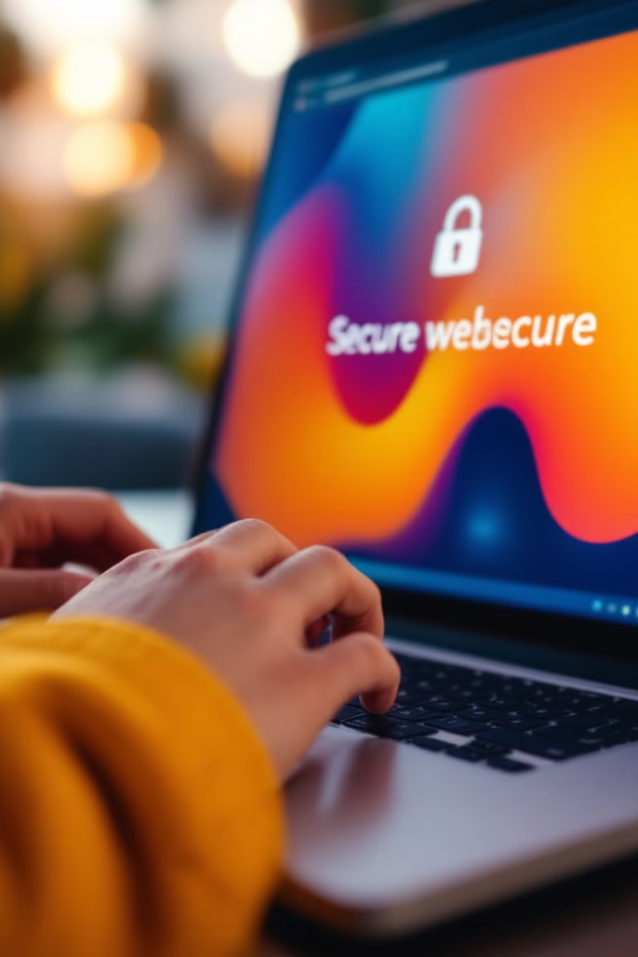
Secure Communication
1
HTTPS
Indicates a secure connection, using encryption to protect data.
2
VPN
Encrypts your internet traffic, protecting privacy and security.
3
Two-Factor Authentication
Adds an extra layer of security by requiring a second verification step.

Slide 26



Building a Strong Security Mindset
Awareness
1
Understanding threats and vulnerabilities.
Best Practices
2
Implementing preventative measures.
Critical Thinking
3
Evaluating information and making informed decisions.

Slide 27

Encryption Fundamentals
1
Encryption Basics
2
Encryption Algorithms
3
Key Management
Encryption transforms data into an unreadable format, making it secure.
Popular algorithms include AES, RSA, and ECC.
Securely storing and managing encryption keys is vital.

Slide 28
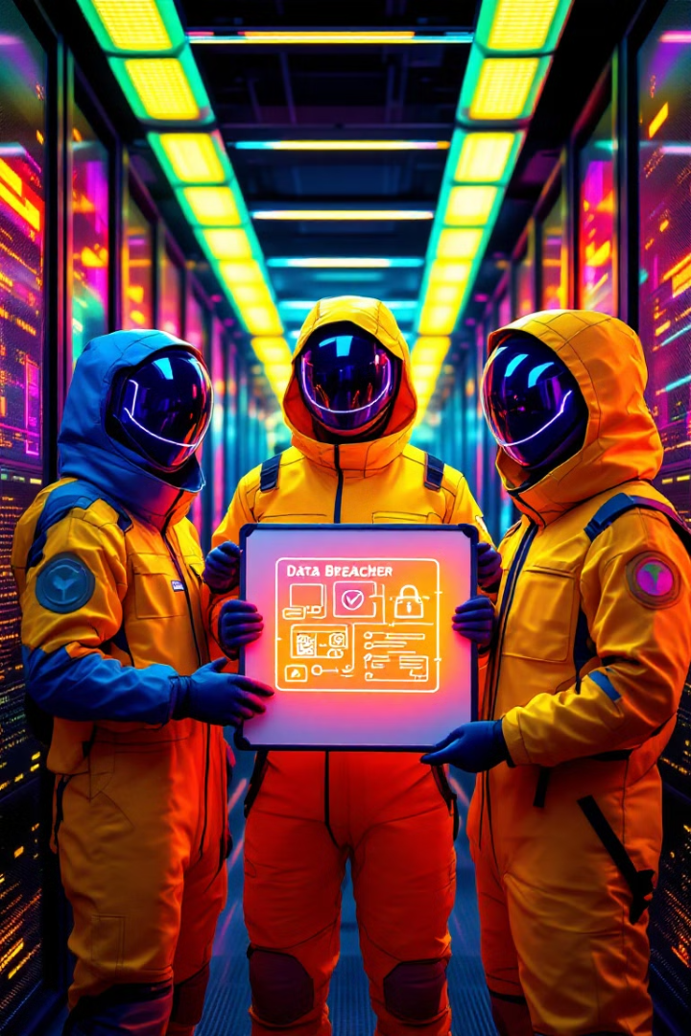
Incident Response: Reporting and Action
1
Report the Breach
Immediately report any suspected breach to the appropriate security team.
2
Contain the Damage
Isolate the affected systems to prevent further spread of the breach.
3
Investigate and Recover
Thoroughly investigate the breach, identify the cause, and restore compromised systems.

Slide 29

Vulnerability Identification: Group Discussion
Scenario-Based Discussion
Identify Weak Points
Brainstorming helps to identify weaknesses in data security practices.
Participants discuss potential vulnerabilities in hypothetical scenarios.
Develop Mitigation Strategies
Participants work together to devise solutions to address identified vulnerabilities.

Slide 30
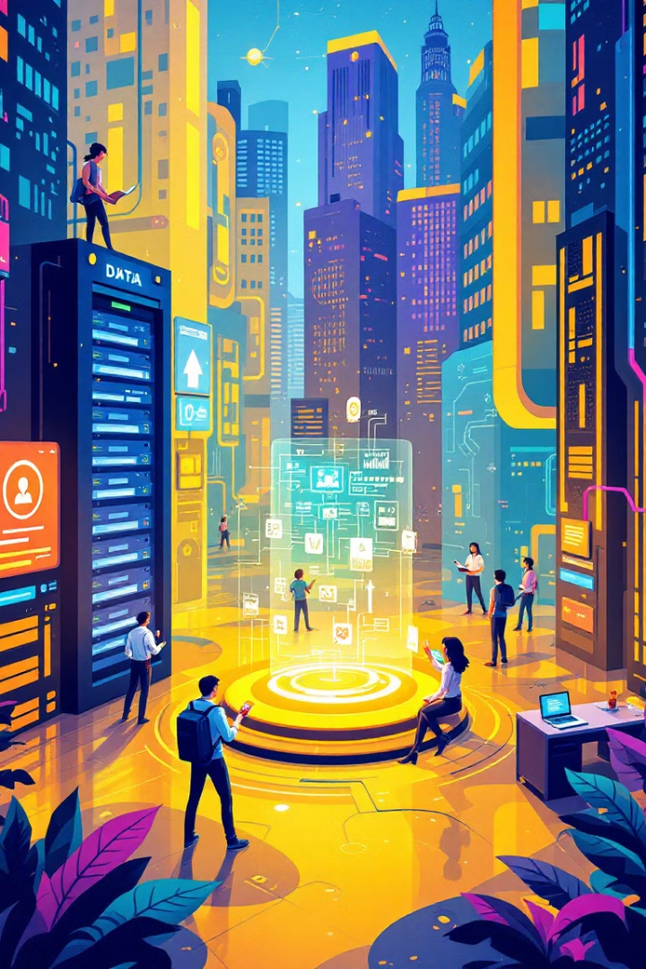



Key Takeaways and Resources
Data Classification is Essential
Prioritize data based on sensitivity to implement appropriate protection measures.
Encryption Enhances Security
Protect sensitive data by converting it into an unreadable format.
Incident Response is Crucial
Develop a plan to effectively manage and respond to data security breaches.

Slide 31

Key Takeaways
Online security is an ongoing process. Staying informed and implementing best practices is crucial to protect your privacy and data. Continuously update your knowledge and adapt your security habits to stay ahead of evolving threats.

Slide 32

Q&A and Next Steps
This concludes our presentation on data security. Now, we welcome any questions you may have.

Slide 33
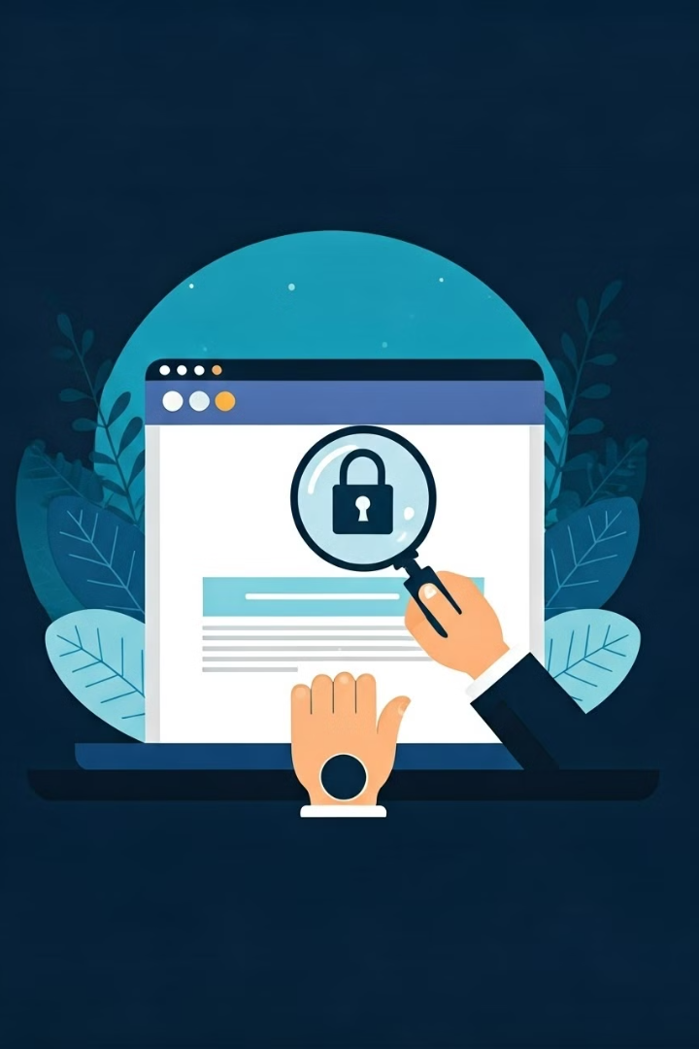




Safe Internet and Device Use

